Slide 1
Survey of Salary Data

Slide 2
Problem Statement (from user perspective)
Maximum Required qualification level for a particular job title
(Monthly Average Salary) Based on Qualification level
(Monthly Average Salary) Based on Years of Experience
(Monthly Average Salary) Based on Age Criteria
(Monthly Average Salary) Based on (Gender specific)
(Monthly Average Salary) Based on Job Title

Slide 3
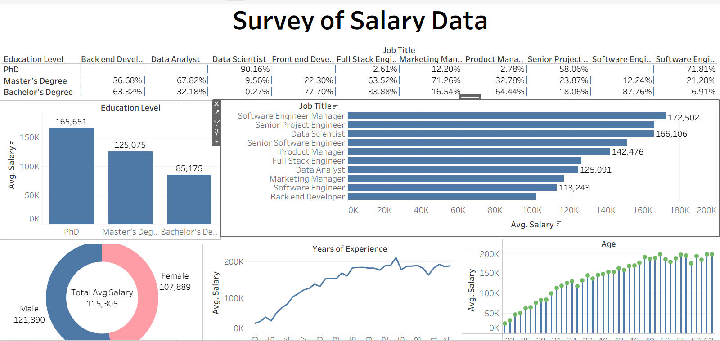

Slide 4
Overall Conclusion
This dashboard will act as an interactive medium for individual professionals which include both (working/non-working) people or even those who wish to start their own start-up and require certain qualified people in their business
Since the usability has nothing such as specific age limit even
students could get help through this dashboard for deciding their
career path or any dream profession.

Slide 5
Thankyou
LinkedIn : htttps://www.linked.com/in/tanish-m-506462309
Dataset: Kaggle.com
Visualization Tool: Tableau
Name:Tanish.D.Malvankar

